Slide 1

Atherosclerosis Risk Estimator App
Gigachads
Ilya Betyaev
Daria Mandel
Tayyab Zain
Muhammad Asif
Hamna Qaseem
Nikita Nikitin
22/01/2023
Notes:
Atherosclerosis Risk App

Slide 2

Problem Statement
Arteries become clogged with fatty substances
Disease goes unnoticed due to no symptoms
>50% of all cases of sudden death
~90% of sudden coronary death
Atherosclerosis is a common disease of aging, such that increasing age is an independent risk factor for the development of atherosclerosis

Slide 3
Market Opportunity & Validation
Growing Awareness of the Importance of Preventative Health Measures
Adoption of Telemedicine and Digital Health Technologies
Increasing Focus on Personalized Medicine
There is a growing demand for tools that can help people proactively manage their health.
There is a growing demand for tools that are convenient, accessible, and cost-effective for health management.
There is a growing market opportunity for an app that can provide personalized recommendations for managing cholesterol levels based on an individual's risk factors.

Slide 4

Value Proposition & Solution
Personalization
Accessibility
Awareness
External factors
Genetic factors
App
Age, BMI, smoke status, Arterial pressure
LOC105375733
SLC17A4
etc.
Atherosclerosis
Design an ML script for “external factors” step
Write a reproducible AI and ML scripts for processing NGS data

Slide 5


Underlying Technologies
Application Part
Bioinformatics part
Machine Learning based pipeline ac>0,8
from FASTQ to VCF and CSV
AI based alignment script
Pleasant and user-friendly design
Detection of “bad” variants
A large field for new opportunities

Slide 6
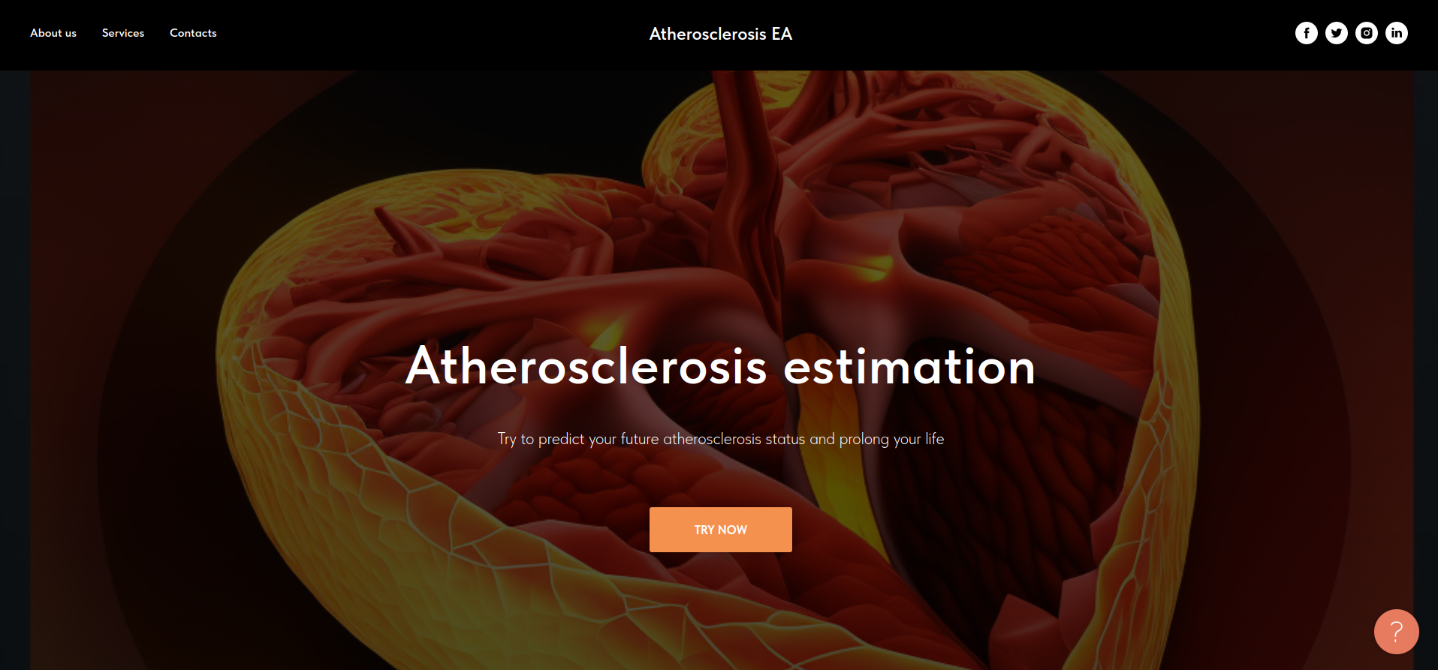
Web-site conception

Slide 7








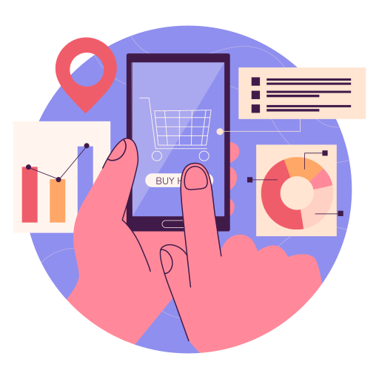
How does our app work?
Free and paid version
Diagnosis

Slide 8


Novelty & IP strategy
Concentrating analysis focus on atherosclerosis
Patentable Technology
IP Strategy
Novelty
High Accuracy
Trademarking
Copyrighting
Data Protection
Considering not only external factors, but also genomics data

Slide 9
Business Model
Key Partners
Key Activities
Value Propositions
Customer Relationships
Customer Segments
App Development
Engagement
Sequencing Laboratory
Personalization
Health-Conscious Individuals
Marketing & Promotion
Support
Feedback
Data Collection & Analysis
Accessibility
Individuals in Underserved Areas
HPC Cluster
Channels
Key Resources
Delivery Company
Awareness
App Store
Individuals at High Risk for Cardiovascular Diseases
Team, Servers & Infrastructure, Investments
Website
Public Speaking
Cost Structure
Revenue Streams
R&D Costs
Promotional Costs
Server & Infrastructure Costs
In-App Purchases
Subscriptions
Sponsorships

Slide 10
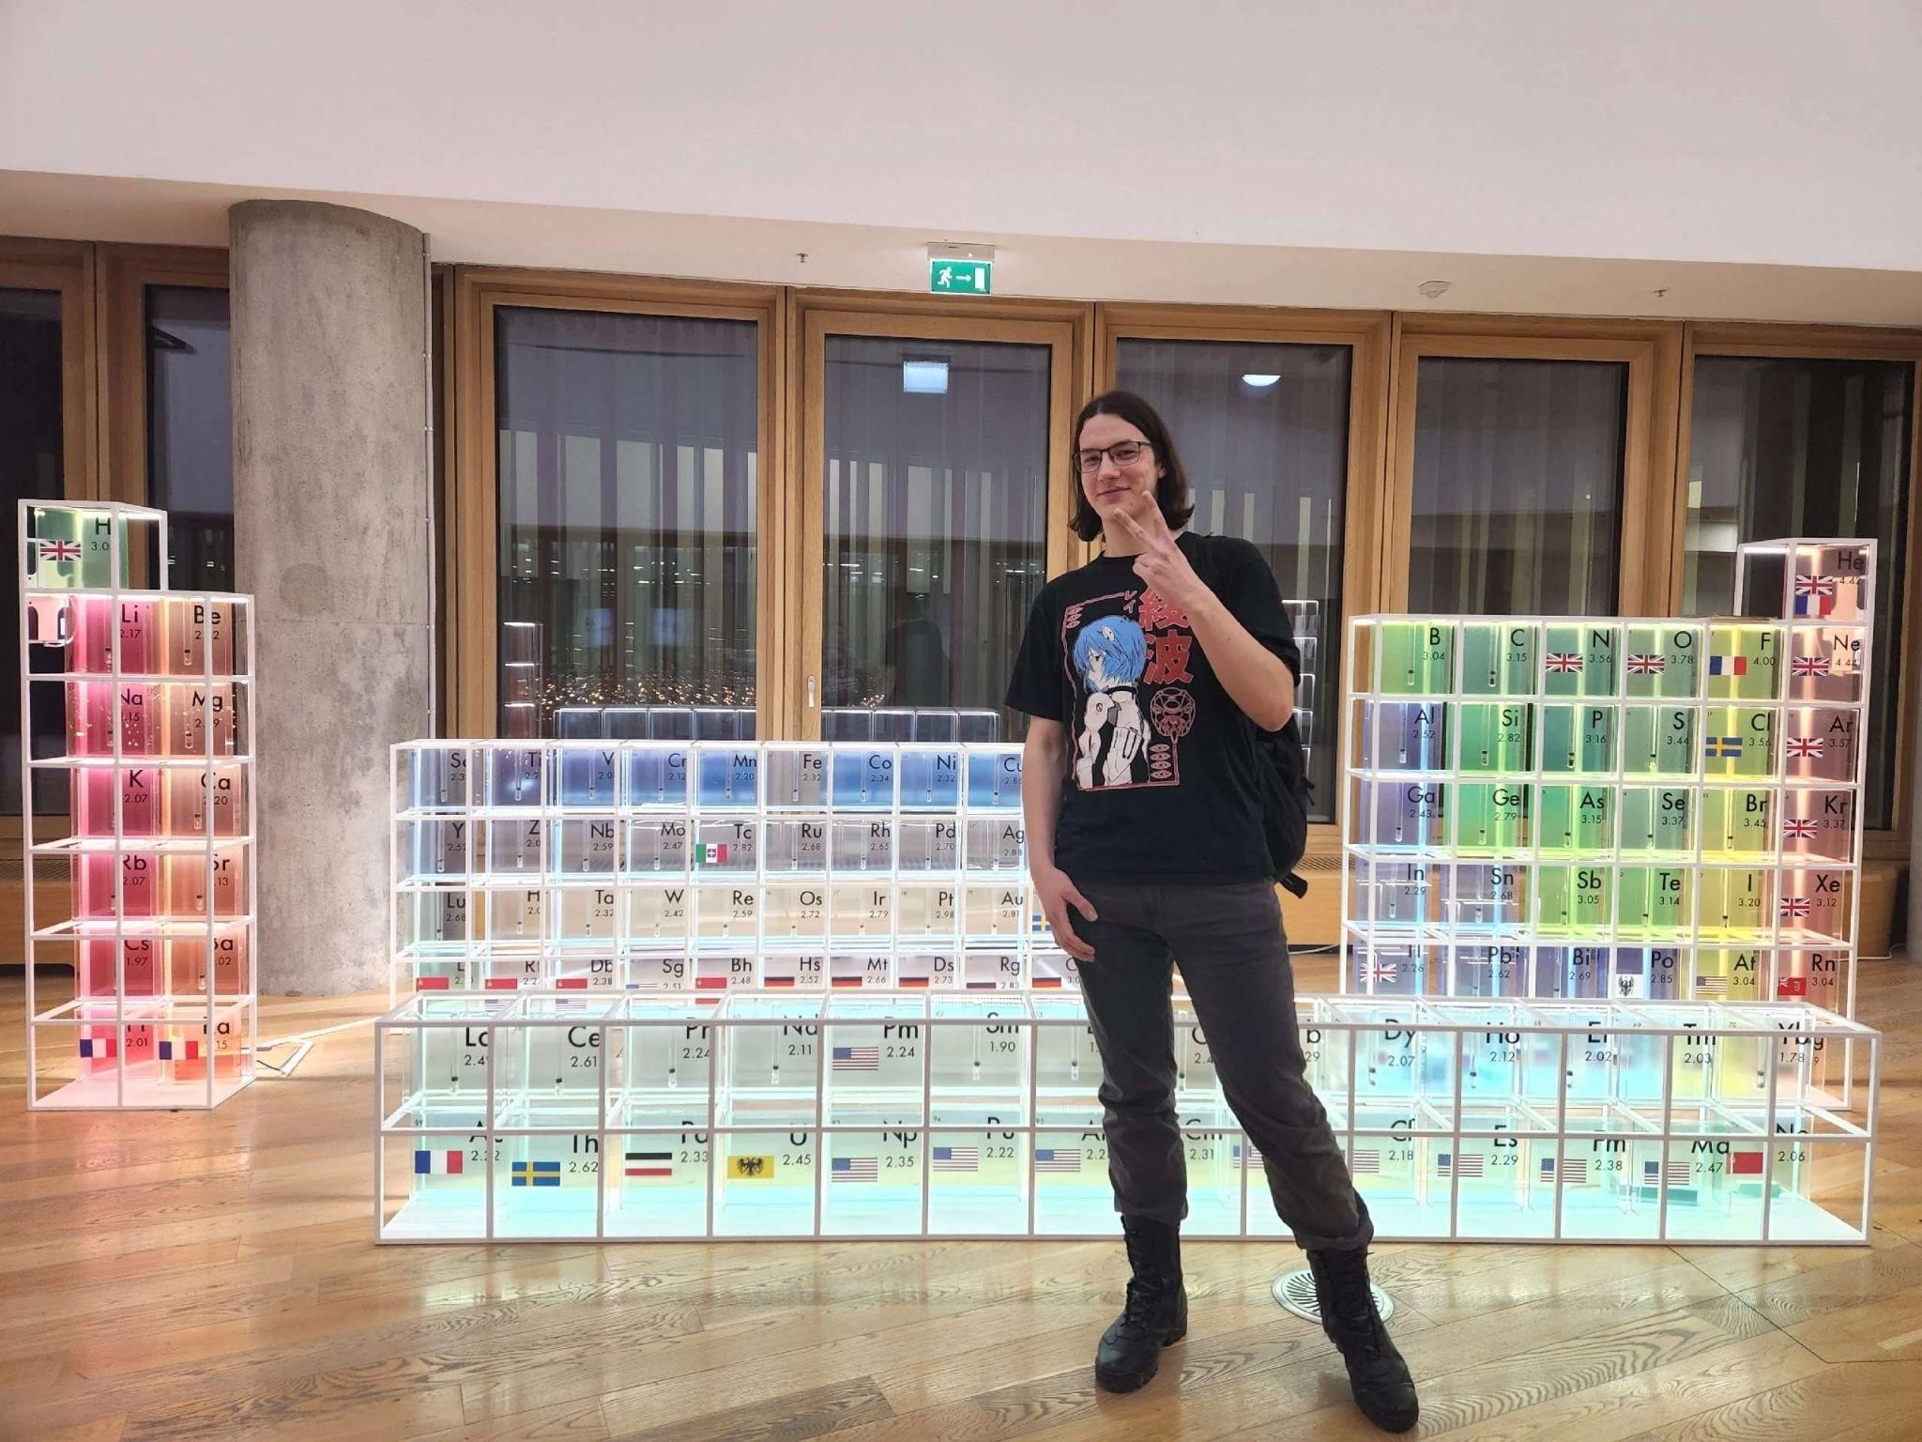

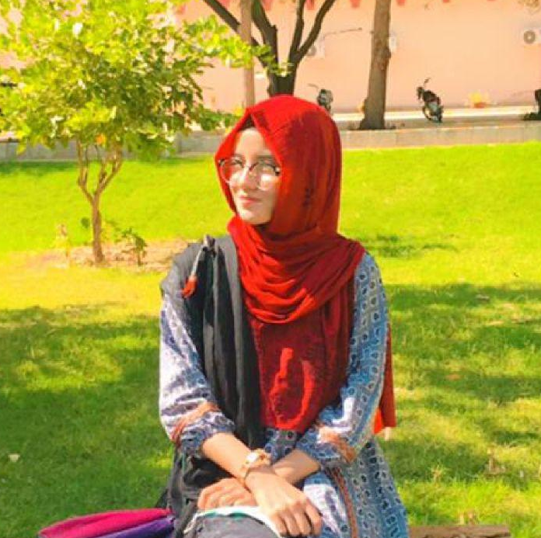


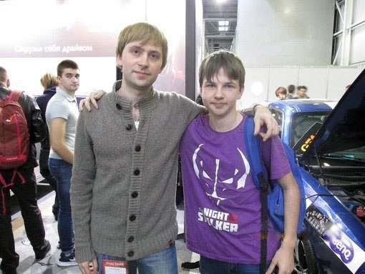
Ilya Betyaev
Daria Mandel
Hamna Qaseem
Team Lead, BSc student in Medical Biochemistry
Bioinformatician, BSc student in Medical Biochemistry
ML Engineer, BSc (Hons) in Data Science
Tayyab Zain
Muhammad Asif
Nikita Nikitin
AI & ML Engineer, BSc in Computer Science
Data Science Engineer, MSc in Electrical AI
Idea Generation, MSc in Pediatrics
Notes:
need information about your education, as well as Asif’s full name

